Slide 1


Graph Algorithms Accelerator
for Heteregenous
CPU-FPGA Architecture
Using a C++ Hardware Description Library
Blaise Pascal Tine

Slide 2
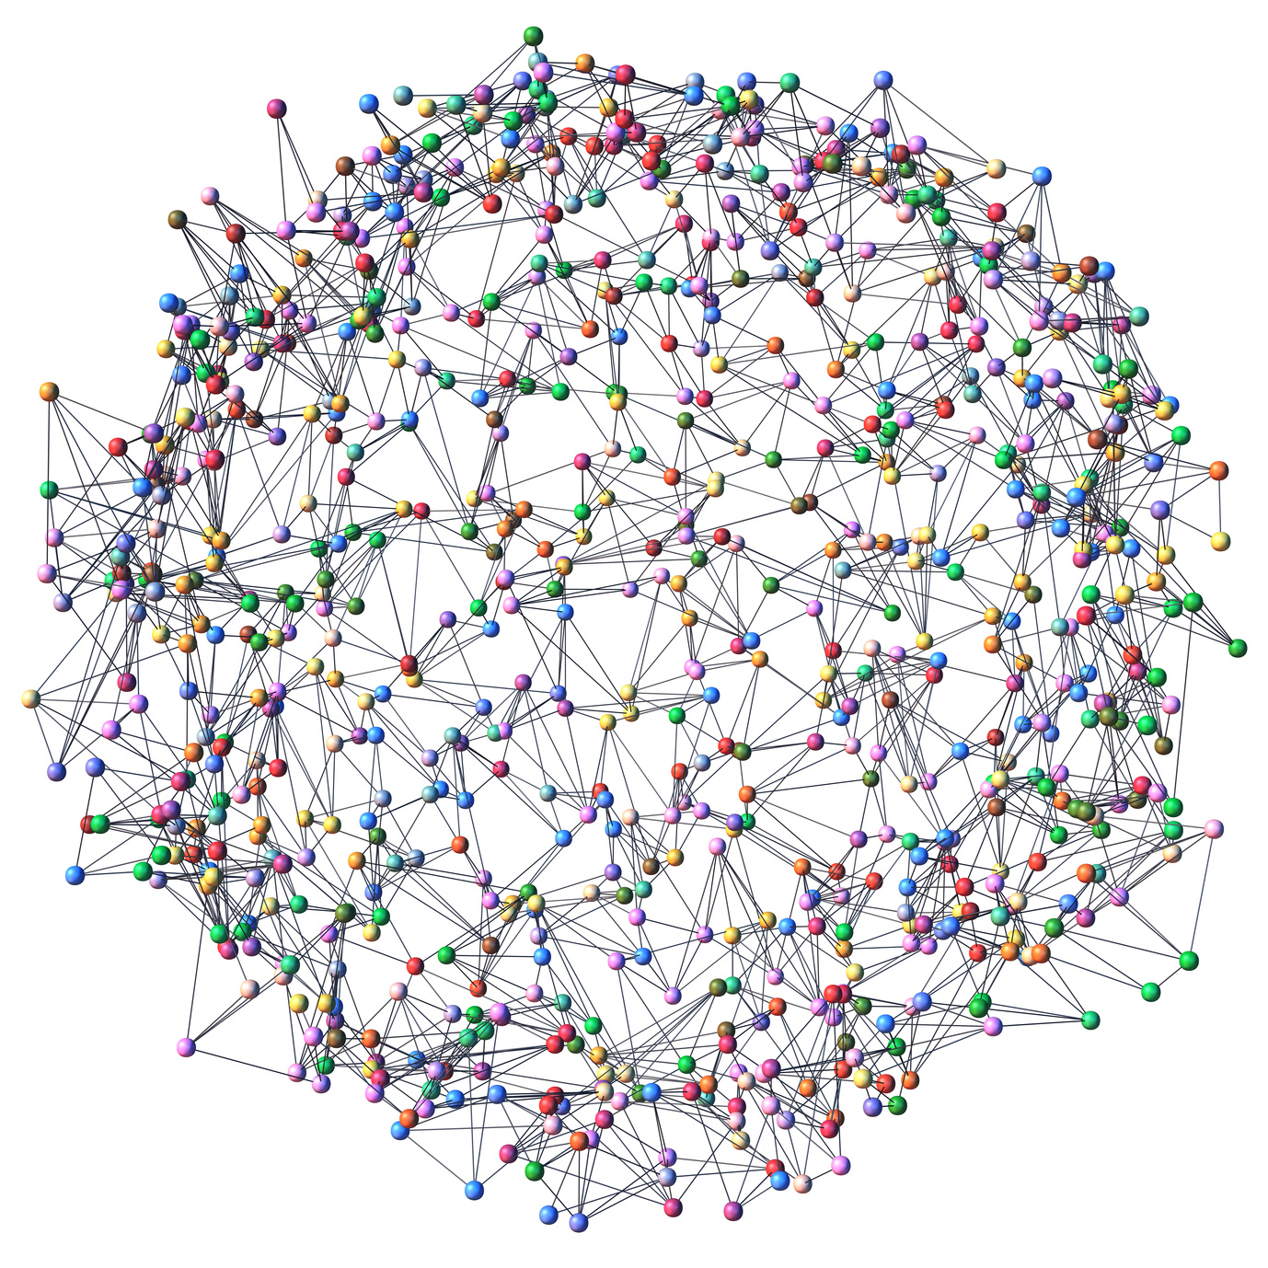
Motivation
Graph Analytics is ubiquitous in Data Centers today
Need efficient computation of large datasets
Need efficient programming abstraction
Emergence of heterogeneous CPU-FPGA platforms
Exploring a high bandwidth SPMV accelerator for this new architecture

Slide 3
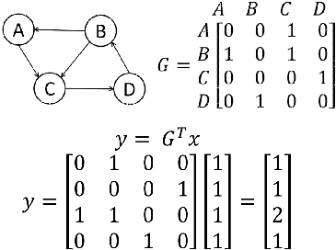
GraphMat Programming Model
A C++ library for Accelerating Graph Algorithms
Converts algorithm to linear Algebra for parallel computation
Represents graphs as sparse matrices
Uses Sparse Matrix Multiplication a computation kernel
[1] Sundaram et al, “GraphMat: High Performance Graph Analytics Made Productive”. VLDB ENdow 2015.

Slide 4
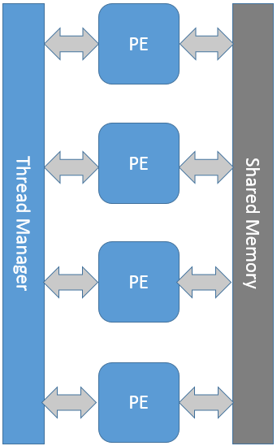
SPMV Accelerator Design
Doubly compressed sparse column-based format (DCSC) for hyperspace matrices
Sparse input vector (bitmask)
Cache-coherent Shared Memory between FPGA and CPU
Processing element for each work item
Thread Manager controls Load/Store units access to PEs

Slide 5
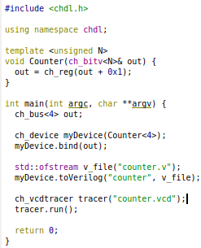
CHDL Implementation
C++ Hardware Design Library
Object-oriented hardware design
Generators via C++ templates
High-level behavioral modeling
int/uint/fixed/float datatypes
Fifo channels
Multi-threaded real-time simulation
C++ simulators interoperability
Generate verilog for FPGA synthesis
Notes:
SMART is 7263 lines of verilog code

Slide 6
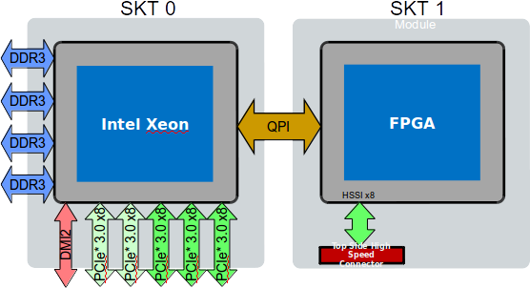
Evaluation
Intel QuickAssist FPGA
Intel Xeon E5-2680 2.8 GHz
L1(32KB), L2(256KB), L3(25MB)
Memory 32 GB DDR3
Altera Stratix V
234K LUT, 393K FF, 52MB
Graph 500 large datasets
Compare CPU vs GPU vs FPGA

Slide 7

Milestomes
CHDL high-level simulation
SPMV RTL design
GraphMat Simulation
CHDL verilog generator
Intel QPI Wrapper design
Intel QuickAssist Evaluation

Slide 8

Questions?

